Slide 1






Parents’ empathic accuracy in coparental
dyadic and triadic interactions
Anthony Mauroy*, Justine Gaugue, Sarah Galdiolo
*Postdoctoral Researcher, Senior Teaching Assistant at the University of Mons, Belgium
anthony.mauroy@umons.ac.be

Slide 2

Superpower or challenge
4

Slide 3





Thoughts
Empathic Accuracy (EA)
Feelings
Relationship
Reduction of family time
How do parents understand each other when interacting with their child
Context
Presence of the child
Bornstein et al. (2020) ; Claxton & Perry-Jenkins (2008) ; Halford et al. (2018) ; Hinnekens et al. (2020) ; Ickes (1990)
5

Slide 4


Who ?
10.31 years (4.61)
40 Parents-child triads
47.5% married
34.03 years (5.97)
32.9 years (4.84)
16.07 months (0.64)
57.5% of boys
6

Slide 5

What ?
Does the presence of the child matter ?
EAD
EAT
Linear Mixed-effects model
Thoughts and/or Feelings ?
Does family time (time usually spent together) matter ?
Couple time
EAD
Child time
EAT
APIM analyses
Triad time
7

Slide 6
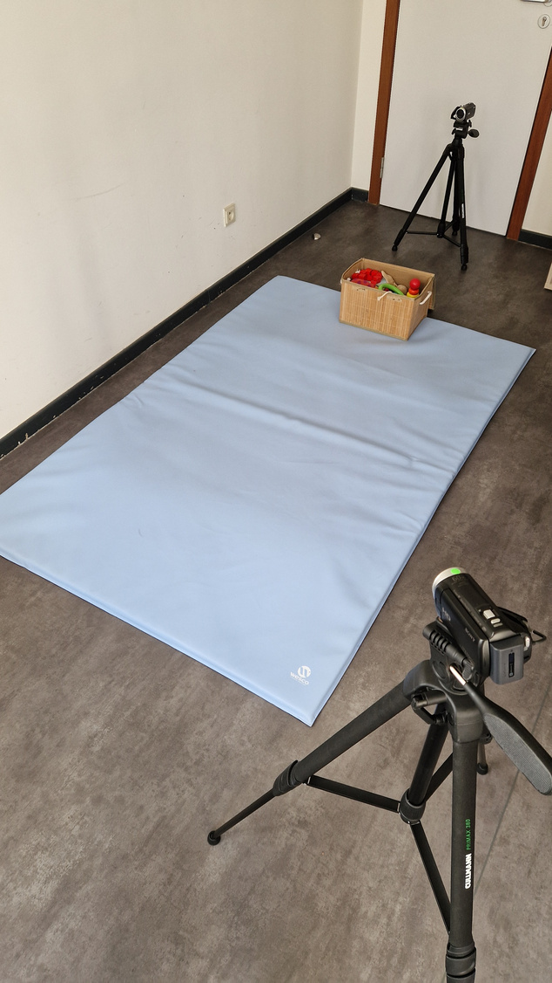
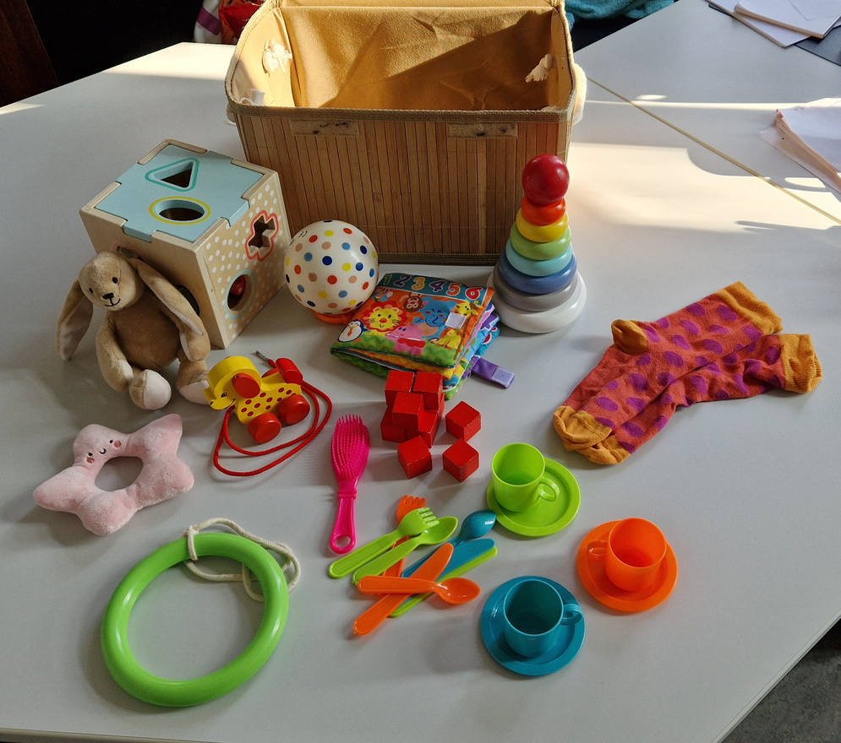
How ?
1
2
Free-play interaction
Thoughts and feelings - recall task
Dyad
Triad
EAD
EAT
Thoughts
Feelings
From 0 to 100
ICC = .86
95% CI [.78, .90]
3
Couple time
Questionnaire - Time spent together (mean hours/day)
Child time
Triad time
Ickes (1983) ; Loop et al. (2017) ; Milek et al. (2017)
8

Slide 7
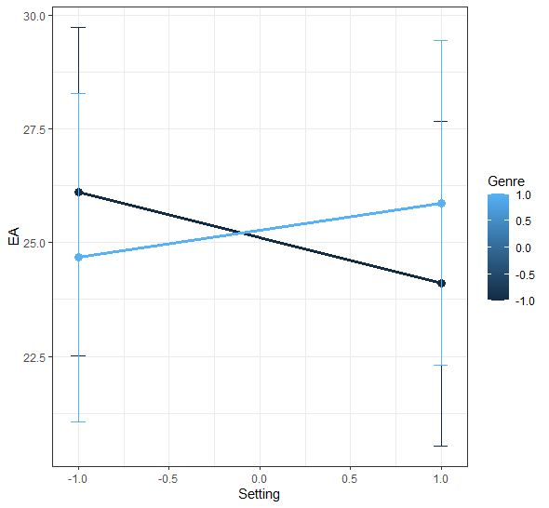
Does the presence of the child matter ?
No difference in dyad vs triad
(B = -0.2; SE = .80 ; p = .799)
nor according to gender
(B = 0.08; SE = .80 ; p = .921)
nor context x gender
(B = 0.80; SE = .80 ; p = .318)
Fathers
Mothers
EAD
EAT
24.45 (12.99)
24.98 (9.55)
Cerrato & Cifre (2018); Hall & Schmid Mast (2007); Jospe et al. (2020); Nomaguchi et al. (2005); Parker (2013); Schulz (2021); Zaki et al. (2009)
9

Slide 8
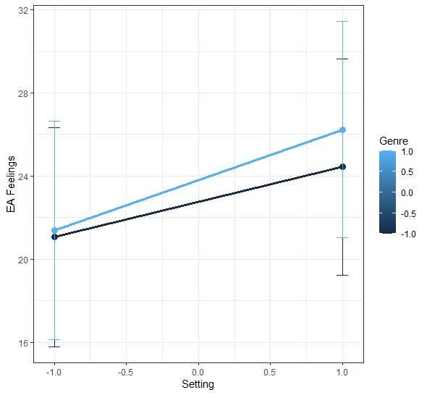
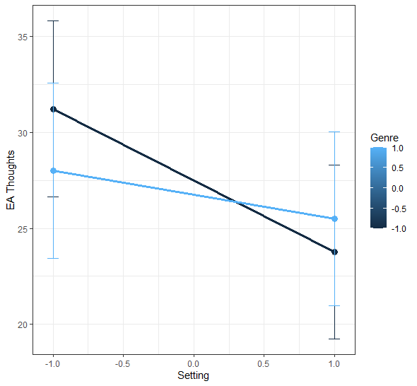
Does the presence of the child matter ?
Fathers
Feelings
Mothers
Thoughts
29.59 (17.14)
24.64 (11.15)
Cerrato & Cifre (2018); Hall & Schmid Mast (2007); Jospe et al. (2020); Nomaguchi et al. (2005); Parker (2013); Schulz (2021); Zaki et al. (2009)
10

Slide 9
Does family time (time usually spent together) matter ?
Couple time
EAD
B = 2.07*
EAT
B = 2.39*
Couple time
EAD
EAT
Triad time
EAD
Note. *p < .05
EAT
Triad time
EAD
Child time
EAD
EAT
EAT
B = 2.84*
Child time
EAD
EAT
Note. *p < .05
Cerrato & Cifre (2018); Hall & Schmid Mast (2007); Jospe et al. (2020); Nomaguchi et al. (2005); Parker (2013); Schulz (2021); Zaki et al. (2009)
11

Slide 10
How do parents understand each other when interacting with their child
Context doesn’t matter, except for thoughts
Father’s time investment is beneficial for empathic accuracy
Superpower or challenge ?
Both !
Cerrato & Cifre (2018); Hall & Schmid Mast (2007); Jospe et al. (2020); Nomaguchi et al. (2005); Parker (2013); Schulz (2021); Zaki et al. (2009)
12

Slide 11


Parents’ empathic accuracy in coparental
dyadic and triadic interactions
Anthony Mauroy*, Justine Gaugue, Sarah Galdiolo
*Postdoctoral Researcher, Senior Teaching Assistant at the University of Mons, Belgium
anthony.mauroy@umons.ac.be
Preprint + References
Get in touch

